Slide 1


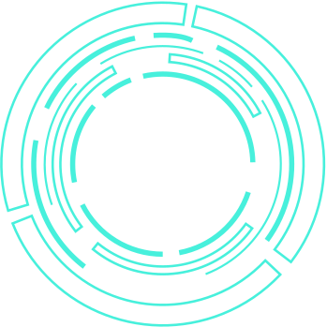
GIT WATCH
A tool to track
Github Repositories
Principal Marker: Dr. John Drake
Supervisor: Dr. James Hoey
Submitted By: Amisha Rastogi(ar668)

Slide 2




GIT WATCH
Problem Statement:
Managing and assessing individual student contributions in group projects is challenging.
No automated way to detect inactivity or low-quality commits.
Traditional GitHub tools lack detailed, real-time insights for module convenors.
Solution:
A web-based platform designed for real-time Git repository monitoring, evaluation, and reporting in academic settings.

Slide 3
GIT WATCH
FEATURES
Essential Features:
Real-time commit tracking.
Inactivity alerts for low contributions.
Commit quality evaluation.
Automated reporting and analytics.
Recommended Features:
Real-time webhook updates, search & filtering, detailed activity logs,automated repository setup.
Optional Features:
AI-based commit quality analysis using open ai api

Slide 4
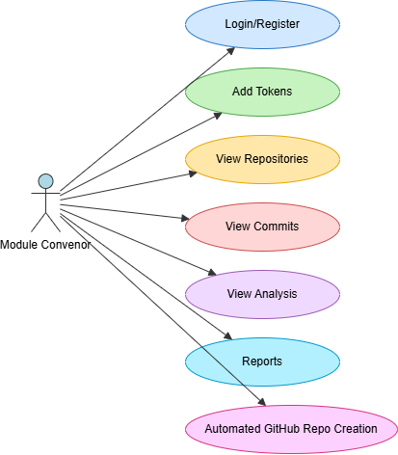
GIT WATCH
Use Case
Diagram

Slide 5
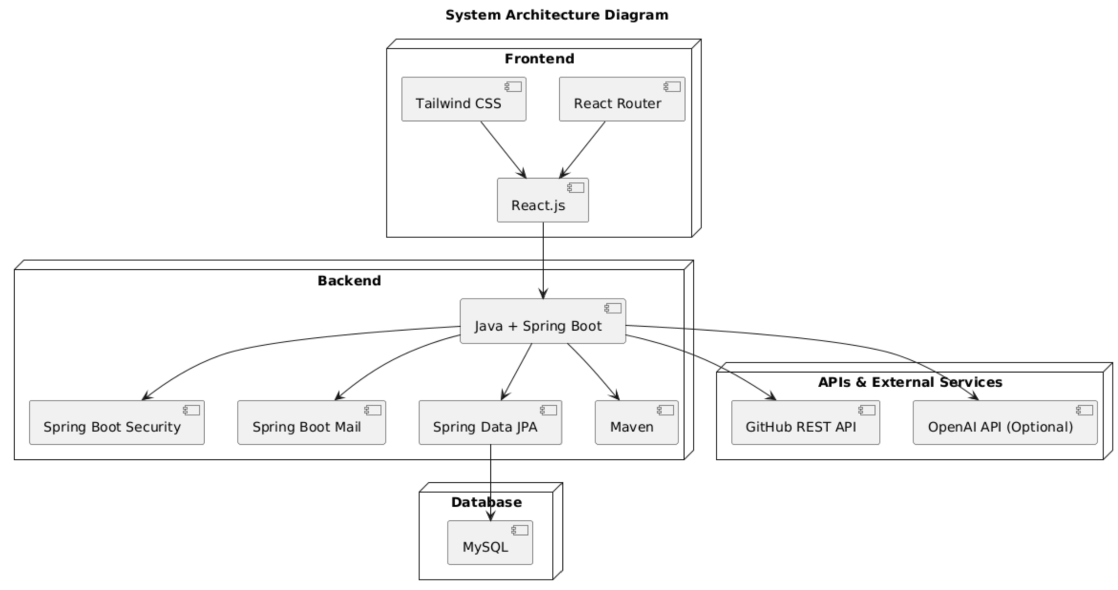
GIT WATCH
System Architecture
Notes:
The system is built using a common architecture called MVC, which stands for Model-View-Controller.

Slide 6

GIT WATCH
Challenges
Efficiently fetching and processing large repository data without performance issues.
Defining and validating commit quality metrics.
Automatic GitHub repository creation, managing student data in form of groups (group making)

Slide 7

GIT WATCH
Conclusion
The project aims to enhance GitHub contribution tracking for student projects.
It will provide real-time monitoring, commit quality assessment, automatic repository creation and performance insights.
-

